Slide 1
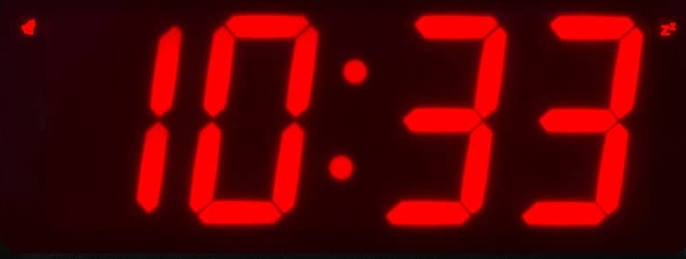
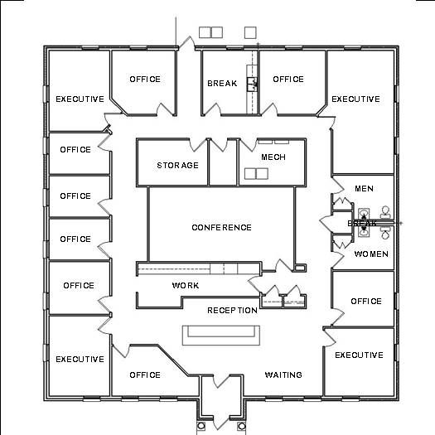
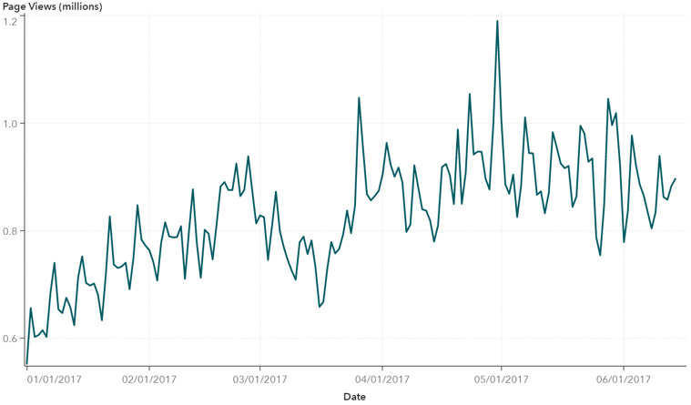
Map
List
Sensor
Category: PM ≡
Sensor: 3
Stats
---
----
-------
--

Slide 2
Map
List
Sensor
Category: PM ≡
Sort
Filter
Add / Remove
Stats: Ave Max Min .....
Sensor: 1
52 103 4
Sensor: 2
52 103 4
Sensor: 3
52 103 4
Sensor: 4
52 103 4
Sensor: 5
52 103 4

Slide 3
Map
List
Sensor
Sensor: 3 ≡
PM
Noise
Temp
Humidity
Stats
---
----
-------
--
PM2.5
Noise
Humidity

